Slide 1
A Clinical Stage Next Generation Stem Cell Therapeutics Company
Investor Presentation
June 2024

Slide 2
Important information
Summary information
This Presentation contains summary information about Cynata Therapeutics Limited and its subsidiaries (CYP) which is current as at 26 June 2024. This Presentation should be read in conjunction with CYP’s other periodic and continuous disclosure information lodged with the Australian Securities Exchange (ASX), which are available at www.asx.com.au.
Not an offer
This Presentation is not a prospectus, product disclosure statement or other offering document under Australian law (and will not be lodged with the ASIC) or any other law. This Presentation is for information purposes only and is not an invitation or offer of securities for subscription, purchase or sale in any jurisdiction. The release, publication or distribution of this Presentation (including an electronic copy) outside Australia may be restricted by law. If you come into possession of this Presentation, you should observe such restrictions. Any non-compliance with these restrictions may contravene applicable securities laws.
Not investment advice
This Presentation does not constitute investment or financial product advice (nor tax, accounting or legal advice) or any recommendation by CYP or its advisers to acquire CYP securities. This Presentation has been prepared without taking account of any person’s individual investment objectives, financial situation or particular needs. Before making an investment decision, prospective investors should consider the appropriateness of the information having regard to their own investment objectives, financial situation and needs and seek legal, accounting and taxation advice appropriate to their jurisdiction. CYP is not licensed to provide financial product advice in respect of CYP securities.
Investment risk and past performance
An investment in CYP securities is subject to known and unknown risks, some of which are beyond the control of CYP and its directors. CYP does not guarantee any particular rate of return or performance of CYP. Past performance cannot be relied upon as an indicator of (and provides no guidance as to) future CYP performance including future share price performance.
Financial data
All financial information in this Presentation is in Australian currency (A$) unless otherwise stated. This Presentation contains historical financial information based on the Company’s results for the quarter to 31 March 2024. This information is disclosed in the Appendix 4C report lodged with the ASX on 30 April 2024. Any discrepancies between totals and sums of components in tables and figures in this Presentation are due to rounding.
Forward-looking statements
This Presentation contains certain ‘forward looking statements’, which can generally be identified by the use of forward looking words such as ‘expect’, ‘anticipate’, ‘likely’, ‘intend’, ‘should’, ‘could’, ‘may’, ‘predict’, ‘plan’, ‘propose’, ‘will’, ‘believe’, ‘forecast’, ‘estimate’, ‘target’, ‘outlook’, ‘guidance’, ‘potential’ and other similar expressions. The forward looking statements contained in this Presentation are not guarantees or predictions of future performance and involve known and unknown risks and uncertainties and other factors, many of which are beyond the control of CYP, its directors and management, and may involve significant elements of subjective judgment and assumptions as to future events which may or may not be correct. There can be no assurance that actual outcomes will not differ materially from these forward looking statements. A number of important factors could cause actual results or performance to differ materially from the forward looking statements. No representation or warranty, express or implied, is made as to the accuracy, likelihood of achievement or reasonableness of any forecasts, prospects, returns or statements in relation to future matters contained in this Presentation. The forward looking statements are based on information available to CYP as at the date of this Presentation. Except as required by law or regulation (including the ASX Listing Rules), CYP and its directors, officers, employees, advisers, agents and intermediaries undertake no obligation to provide any additional or updated information whether as a result of new information, future events or results or otherwise. You are strongly cautioned not to place undue reliance on forward-looking statements, particularly in light of the current economic climate and the significant volatility, uncertainty and disruption caused by the outbreak of COVID-19.
Industry and Market data
Certain market and industry data used in connection with this Presentation may have been obtained from research, surveys or studies conducted by third parties, including industry or general publications. Neither CYP nor its representatives have independently verified any such market or industry data provided by third parties or industry or general publications.
Disclaimer
To the maximum extent permitted by law, CYP and its advisers, affiliates, related bodies corporate, directors, officers, partners, employees and agents (Related Persons) exclude and disclaim all liability, including without limitation for negligence, for any expenses, losses, damages or costs arising from this Presentation or reliance on anything contained in or omitted from it. To the maximum extent permitted by law, CYP and its Related Persons make no representation or warranty, express or implied, as to the currency, accuracy, reliability or completeness of information in this Presentation and disclaim any obligation or undertaking to release any update or revision to the information in this Presentation to reflect any change in expectations or assumptions. Statements made in this Presentation are made only as at the date of this Presentation. The information in this Presentation remains subject to change without notice.

Slide 3
Company highlights
Revolutionary Cymerus™ manufacturing platform
Mesenchymal stem cells (MSCs)¹ have shown potential to treat a wide range of illnesses,² but standard manufacture requires ongoing supply of new donors → challenges with consistency, potency and scale
The patented Cymerus™ platform is based on induced pluripotent stem cell (iPSC) technology
Overcomes major obstacle to commercialisation in this highly promising field, by enabling production of an effectively limitless quantity of consistent, high-quality MSC doses from a single blood donation
Compelling clinical data
Acute graft versus host disease (aGvHD) Phase 1: 53% complete response; 87% overall response
Diabetic foot ulcer (DFU) Phase 1: 88% median wound surface area reduction vs 51% in controls³
Rich clinical pipeline
Three major randomised controlled clinical trial readouts upcoming: DFU (Ph 1) – late 2024/early 2025; aGvHD (Ph 2) – 2H 2025; and osteoarthritis (Ph 3) – early 2026
New trial in kidney transplantation to commence in mid 2024

Slide 4
FY 2024 – a year of progress
Completion of patient enrolment in two randomised controlled trials
Phase 3 osteoarthritis – enrolment completed November 2023
Phase 1 DFU – enrolment completed April 2024
Further encouraging clinical efficacy data
Promising initial data from ongoing DFU trial released in February 2024
New trials adding to rich pipeline
Global Phase 2 aGvHD trial – first patient enrolled in March 2024
New kidney transplant trial approved and ready to commence
Senior management team strengthened
New Chief Business Officer position created to drive next stage of commercial growth (Dr Mathias Kroll – commenced Apr 2024)

Slide 5
Revolutionary iPSC-based Cymerus™ Manufacturing Platform

Slide 6
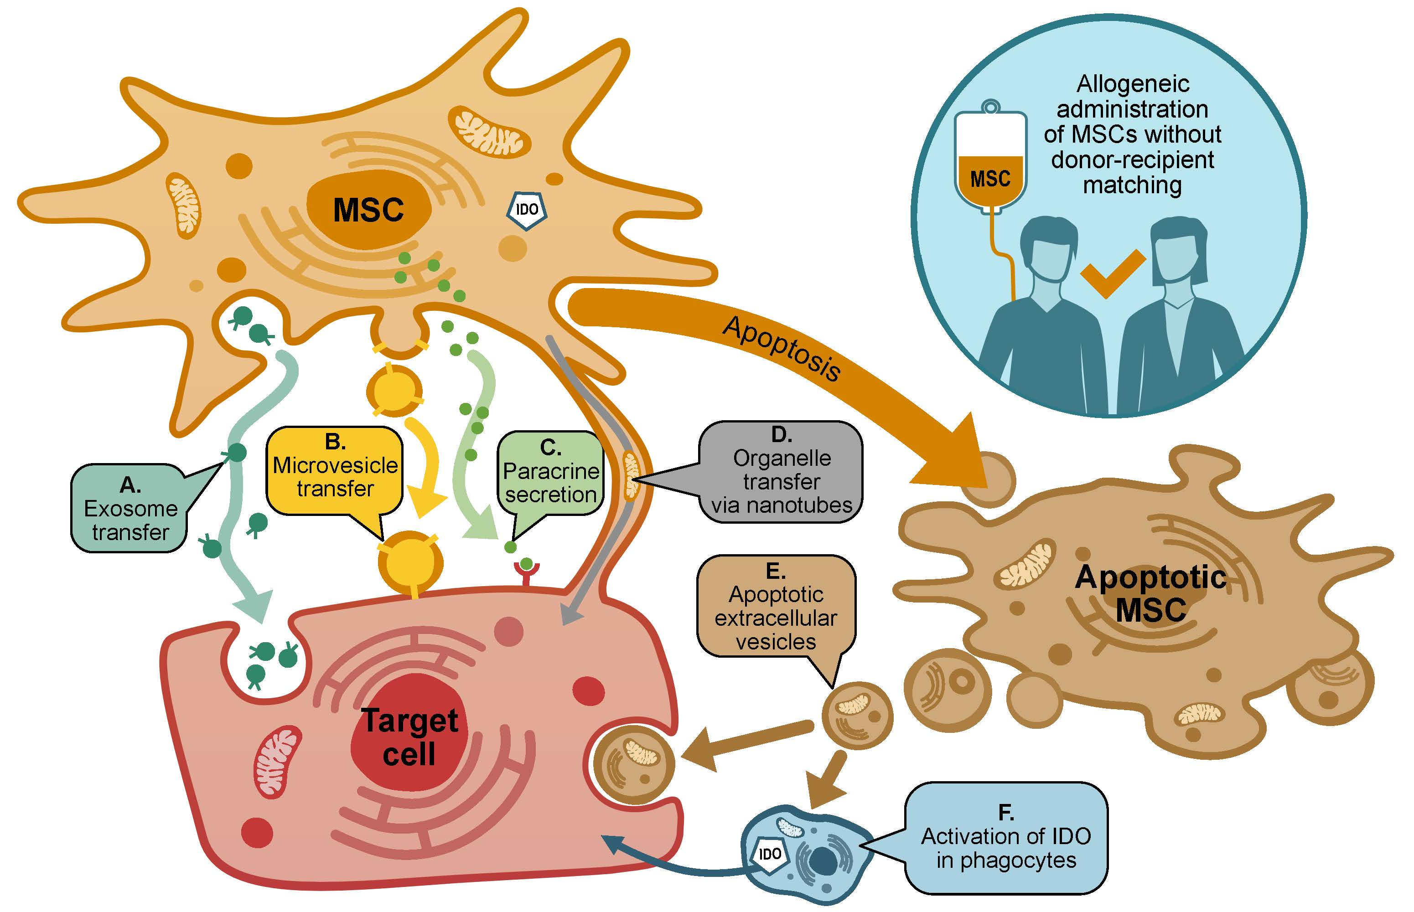
Therapeutic potential of MSCs
Mesenchymal stem cells¹ (MSCs):
Promote an immunomodulatory environment²
The “sensor and switcher of the immune system”³
Promote tissue repair and regeneration
Can be used without matching donors to recipients
Can be engineered to express other functional/therapeutic molecules
However, with conventional manufacturing methods, there are consistency, potency and scalability challenges

Slide 7
Advantages of iPSC-based platform
Induced pluripotent stem cells (iPSCs):
Mature adult cells reprogrammed to become pluripotent, which means:
Effectively limitless proliferation capacity
Potential to differentiate into any adult cell type (including MSCs)
Similar properties to embryonic stem cells … but iPSCs are derived from adult donors, so they avoid ethical controversy associated with embryonic stem cells
→ iPSCs are ideal starting material for commercial production of cellular products

Slide 8
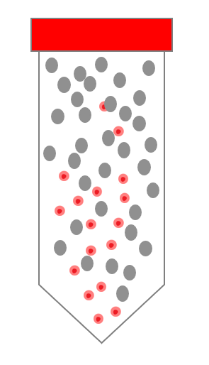
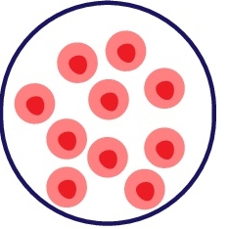
Conventional MSC process
Major challenges:
Logistically challenging
Inter-donor variability – inconsistent activity in MSCs from different donors
MSCs undergo functional changes and loss of potency during extensive culture expansion
Ongoing need for new donors
MSC isolation
Culture expansion
Substantial inter-donor variability
Small number of MSCs per donation
Extensive MSC culture expansion required
Cymerus™ iPSC-based process
Advantages of Cymerus™ platform:
Effectively limitless iPSC expansion potential
Avoids need for new donors
Avoids inter-donor variability
Avoids extensive MSC expansion
High level potency, consistency and scalability
One donor, one time
Reprogramming & iPSC expansion
Differentiation into MSCs & culture expansion
Avoids inter-donor
variability
Effectively limitless expansion potential
Minimal MSC
culture expansion
Robust patent protection

Slide 9
Strategic partnership with Fujifilm
Fujifilm: one of largest healthcare conglomerates globally, with significant assets in biotechnology sector, bolstered by recent multi-billion dollar investments
Fujifilm Cellular Dynamics Inc (FCDI: subsidiary of Fujifilm) developed the original iPSC line used in Cynata’s Cymerus™ manufacturing process
Cymerus™ manufacturing process being established at FCDI, with Cynata’s progress showcasing Fujifilm’s iPSC platform
Fujifilm holds a 4.5% shareholding in Cynata

Slide 10
Compelling Clinical Data:
CYP-001 for aGvHD

Slide 11
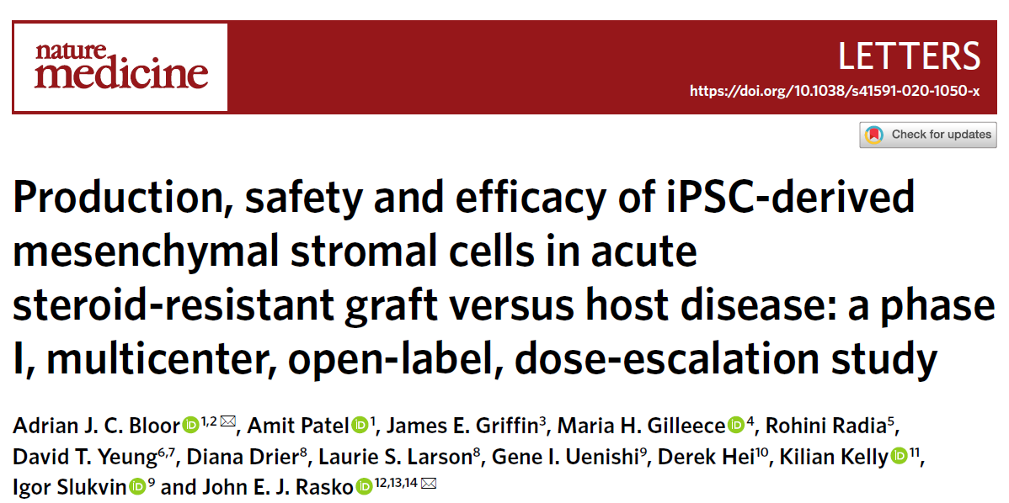
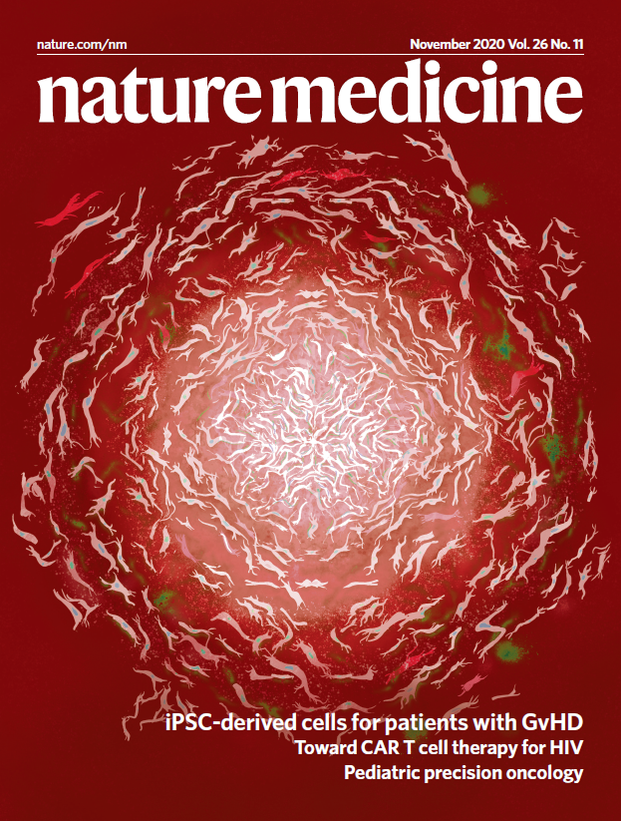
CYP-001: Two Nature Medicine publications
Phase 1 trial of CYP-001 was the first completed clinical trial worldwide with any iPSC-derived product

Slide 12
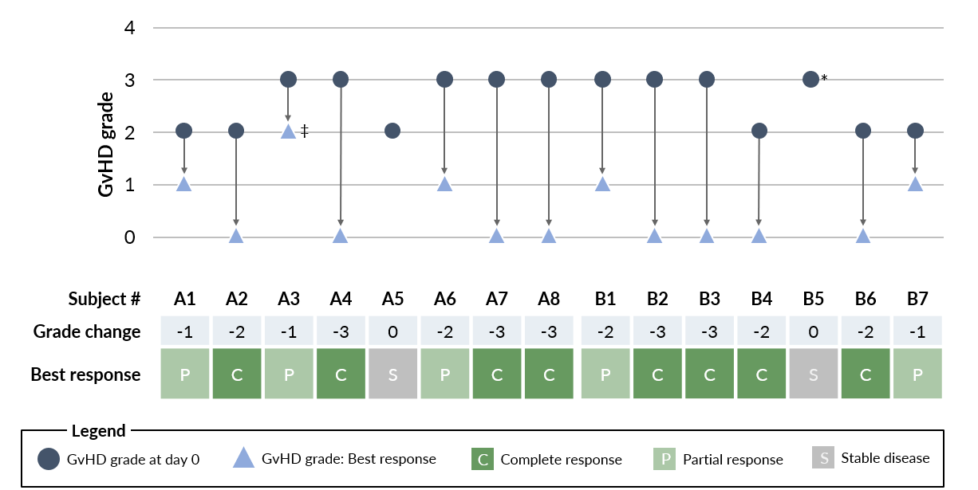
aGvHD | Phase 1 clinical trial - results
Product: CYP-001 (Cymerus™ MSCs for intravenous infusion)
Trial conducted in 15 patients with steroid-resistant aGvHD
CYP-001 was shown to be safe and well tolerated, with sustained outcomes up to 2 years after the first infusion
No serious adverse events or other safety concerns related to CYP-001
Very encouraging response rates and overall survival
Complete response
53%
Overall response
87%
2yr survival
60%

Slide 13
aGvHD treatment landscape
First line treatment for aGvHD is corticosteroids – but up to 50% fail to respond – known as steroid-resistant aGvHD (SR-aGvHD)
Numerous other therapies (e.g. immunosuppressants) have been investigated for SR-aGvHD, but most have limited efficacy and/or problematic safety profiles
Ruxolitinib (a JAK kinase inhibitor):
Approved for treatment of SR-aGvHD in 2019 by the US FDA
Forecast sales of US$4.5b in 2024¹
Led to relatively good response rates in SR-aGvHD, but no apparent improvement in overall survival
Associated with a high rate of potentially serious adverse reactions
➔ There remains a significant unmet need for safer and more effective aGvHD treatments

Slide 14
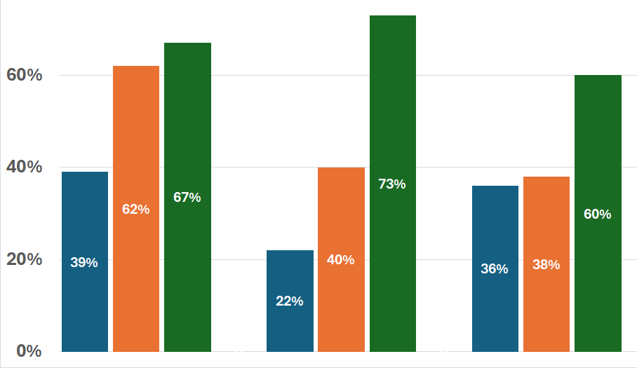
Efficacy of CYP-001 vs other treatments in SR-aGvHD
Overall Response
at Day 28
Overall Response
at Day 56-60¹
Overall Survival
at 18 months
Overall response rates for BAT an Rux declined between D28 and D56
Overall response rate for CYP-001 increased between D28 and D60
Overall survival rate for CYP-001 was 60% at both 18 and 24 months
Overall survival rates for BAT and Rux were 36% and 38% at 18 months, and not evaluable at 24 months
BAT = “best available therapy” in study NCT02913261 - other therapies commonly used in patients with steroid-resistant acute graft versus host disease (SR-aGvHD)
Rux = ruxolitinib (now approved for SR-aGvHD) in study NCT02913261
CYP = CYP-001 in study NCT02923375
BAT Rux CYP BAT Rux CYP BAT Rux CYP

Slide 15
Safety of CYP-001 vs other treatments in SR-aGvHD
No safety concerns related to CYP-001 have been identified
Conversely, adverse reactions to ruxolitinib are common
Grade 3-4 (serious/life-threatening) adverse reactions to ruxolitinib in aGvHD patients include:¹
Adverse Reaction | Grade 3-4 Incidence
Infections (type of infection not specified) | 41%
Bacterial infections | 28%
Haemorrhage (bleeding) | 20%
Fatigue | 14%
Viral infections | 14%
Hypertension (high blood pressure) | 13%
Oedema (fluid retention) | 13%
Thrombosis (blood clots) | 11%
Blood disorders (thrombocytopenia, anaemia, neutropenia) | 61%, 45%, 40%

Slide 16
CYP-006TK for DFU

Slide 17
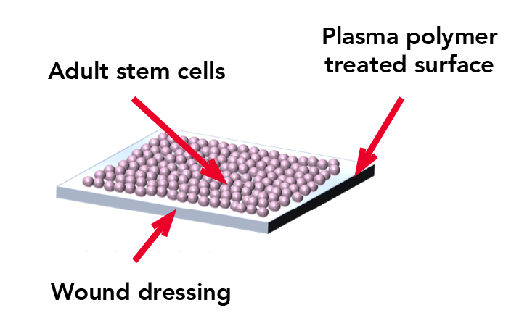
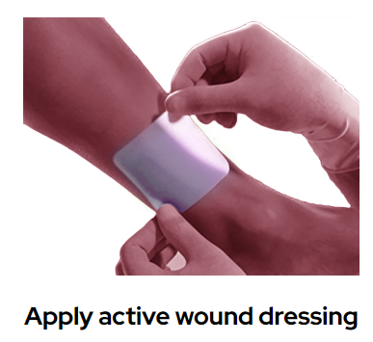
CYP-006TK – a novel topical MSC product
iPSC-derived MSCs
CYP-006TK utilises a proprietary surface-coating, optimised for the delivery of MSCs directly to the wound bed
Technology exclusively licenced to Cynata by Tekcyte Limited

Slide 18
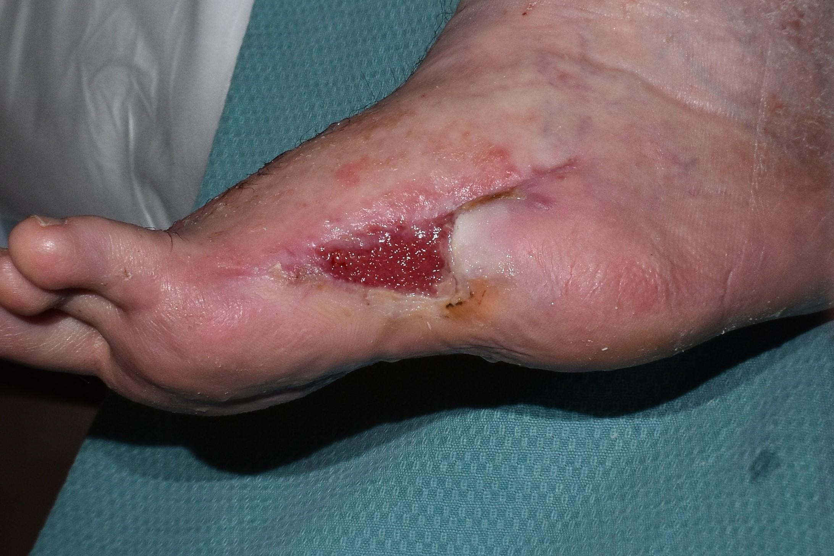
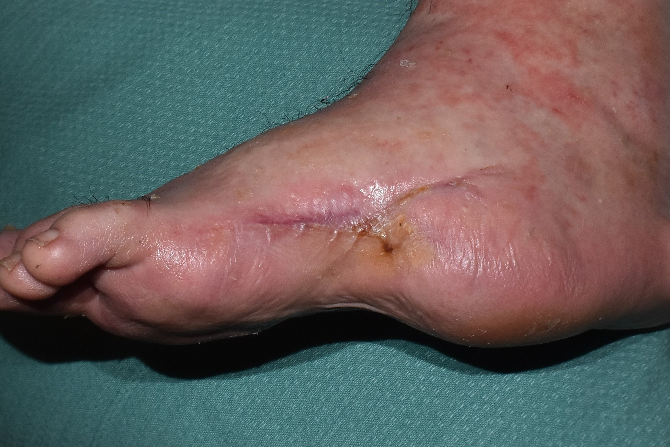
DFU | Phase 1 clinical trial – initial data
Product: CYP-006TK (topical Cymerus™ MSC wound dressing)
Ongoing trial in non-healing diabetic foot ulcer (DFU)
Patients randomised to receive standard of care (SoC) or CYP-006TK for 4 weeks, followed by SoC
In the first 16 patients enrolled in the trial (8 per group), after 10 weeks’ follow-up, the median reduction in wound surface area was:
87.6% in the active CYP-006TK group
compared to 51.1% in SoC group
Example of ulcer healing in patient treated with CYP-006TK:
Day 0
Day 28
For further information: https://clinicaltrials.gov/study/NCT05165628

Slide 19
Rich Clinical Pipeline – Multiple Upcoming Data Readouts

Slide 20
Advanced and diverse clinical pipeline
Indication
Trial phase
Market opportunity
Acute Graft vs Host Disease (aGvHD)
CYP-001
(FDA Orphan Designation)
Phase 2 underway
US$600m¹
Cynata Sponsored
Phase 1 underway
(patient enrolment complete)
Diabetic Foot Ulcers (DFU)
CYP-006TK
US$9.6bn²
Osteoarthritis (OA)
CYP-004
(managed by USYD, funded by NHMRC)
Phase 3 underway (patient enrolment complete)
US$11.6bn³
Partnered
Renal Transplantation (Renal)
CYP-001
(managed and funded by LUMC)
Phase 1 approved
US$5.9bn⁴

Slide 21
aGvHD | Phase 2 clinical trial
Product | CYP-001 (Cymerus™ iPSC-derived MSCs for intravenous infusion)
Indication | High risk acute graft versus host disease (aGvHD)¹
Study Design | Randomised controlled trial in ~60 adults (steroids + CYP-001 vs steroids + placebo) Primary objective is to assess efficacy of CYP-001 based on Overall Response Rate at Day 28
Study Conduct | Clinical sites in USA, Europe and Australia Regulatory/ethics clearance secured in all participating jurisdictions – including IND from US FDA First patient enrolled – March 2024 Aiming to complete patient enrolment by end of calendar year 2024
Results | Primary evaluation results anticipated in 2H CY 2025
aGvHD may occur after bone marrow transplantation/similar procedures, due to donor immune cells (from the “graft”) attacking the transplant recipient (the “host”)
For further information: https://clinicaltrials.gov/study/NCT05643638

Slide 22
DFU | Phase 1 clinical trial
Product | CYP-006TK (Novel silicone dressing seeded with Cymerus™ iPSC-derived MSCs)
Indication | Non-healing diabetic foot ulcers (DFU)
Study Design | Randomised controlled trial in ~30 adults Patients randomised to receive either standard of care or CYP-006TK for 4 weeks, followed by standard of care Primary objective is safety; efficacy measures include wound healing, pain and quality of life
Study Conduct | Clinical sites in Australia (Adelaide and Perth) Patient enrolment complete (April 2024) Last patient visit expected ~September 2024
Results | Positive initial results from first 16 patients – median reduction in wound surface area after 10 weeks was 87.6% in CYP-006TK group compared to 51.1% in controls (n=8 per group) Final results anticipated in Q4 2024 or Q1 2025
For further information: https://clinicaltrials.gov/study/NCT05165628

Slide 23
OA | Phase 3 clinical trial¹
Product | CYP-004 (Cymerus™ iPSC-derived MSCs for intra-articular injection)
Indication | Osteoarthritis (OA) of the knee (Kellgren-Lawrence Grade 2-3)
Study Design | Randomised, double-blind placebo-controlled trial in ~320 adults Each participant receives 3 injections over 12 months; follow-up of 24 months from first dose Co-primary endpoints are reduction of knee symptoms and measure of cartilage loss
Study Conduct | Trial conducted by University of Sydney, funded by Australian Government NHMRC grant Clinical centres in Australia (Sydney and Hobart) Patient enrolment complete (November 2023) Last patient last visit expected ~November 2025
Results | Results anticipated in H1 CY 2026
Clinical trial entitled Stem Cells as a symptom – and strUcture-modifying Treatment for medial tibiofemoral OsteoaRthritis: a randomised placebo-controlled trial (SCUlpTOR).
NHMRC: National Health and Medical Research Council
For further information: https://www.anzctr.org.au/Trial/Registration/TrialReview.aspx?id=379726&isReview=true

Slide 24
Renal transplant | Phase 1 clinical trial
Product | CYP-001 (Cymerus™ iPSC-derived MSCs for intravenous infusion)
Indication | Prevention of kidney transplant rejection
Study Design | ~16 patients to receive CYP-001 after kidney transplantation: cohort 1 (n=3); cohort 2 (n=3); cohort 3 (n=10) Trial will evaluate safety (all cohorts) and efficacy of MSCs in facilitating reduction of calcineurin inhibitors (anti-rejection medication; Cohort 3)
Study Conduct | Trial to be conducted and funded by Leiden University Medical Center (LUMC), Netherlands Regulatory and ethics approvals in place; final trial start-up activities ongoing Aiming to commence patient enrolment in mid 2024
Results | Results of Cohort 1 anticipated in late 2024

Slide 25
Strategy, Outlook and Corporate Overview

Slide 26
Research partnerships
Large body of positive preclinical data generated via R&D partnerships:
GvHD
Diabetic wounds
Critical limb ischaemia
Organ transplant rejection
Osteoarthritis
Respiratory disorders (including asthma, pulmonary fibrosis, acute respiratory distress syndrome)
Sepsis
Cardiovascular disorders (including coronary artery disease, myocardial infarction)
Cytokine release syndrome
Glioblastoma
Several of these studies have been published in peer-reviewed journals – see cynata.com/science_publications
Studies conducted in partnership with leading research groups worldwide

Slide 27
Commercial partnering
Several distinct products in development → potential for multiple partnerships
Reinvestment of proceeds to maximise potential of the platform
Platform also available to partners pursuing other indications and/or engineered MSC applications

Slide 28
Corporate overview
Cynata has been listed on the Australian Securities Exchange (ASX) since 2013 (Ticker: CYP)
Shareholder distribution
Substantial shareholders (>5%)
Bioscience Managers
 | 13.1%
Fidelity
Remaining Top 20
Bioscience Managers is an international healthcare investment firm headquarter in Melbourne that finances and enables innovative science and technology with the potential to transform healthcare.
Other
Financial information
 | 10.0%
Share price (26 June 2024) | A$0.28
Shares on issue | 179m
Market capitalisation | ~A$50m
Cash¹ | ~A$9.0m
Fidelity International is a world leading investment and asset management firm, responsible for total client assets of >US$750 billion, from clients across Asia Pacific, Europe, the Middle East, South America and Canada.
28

Slide 29
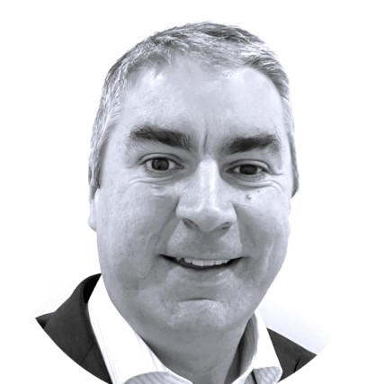
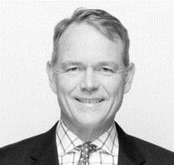
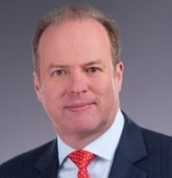
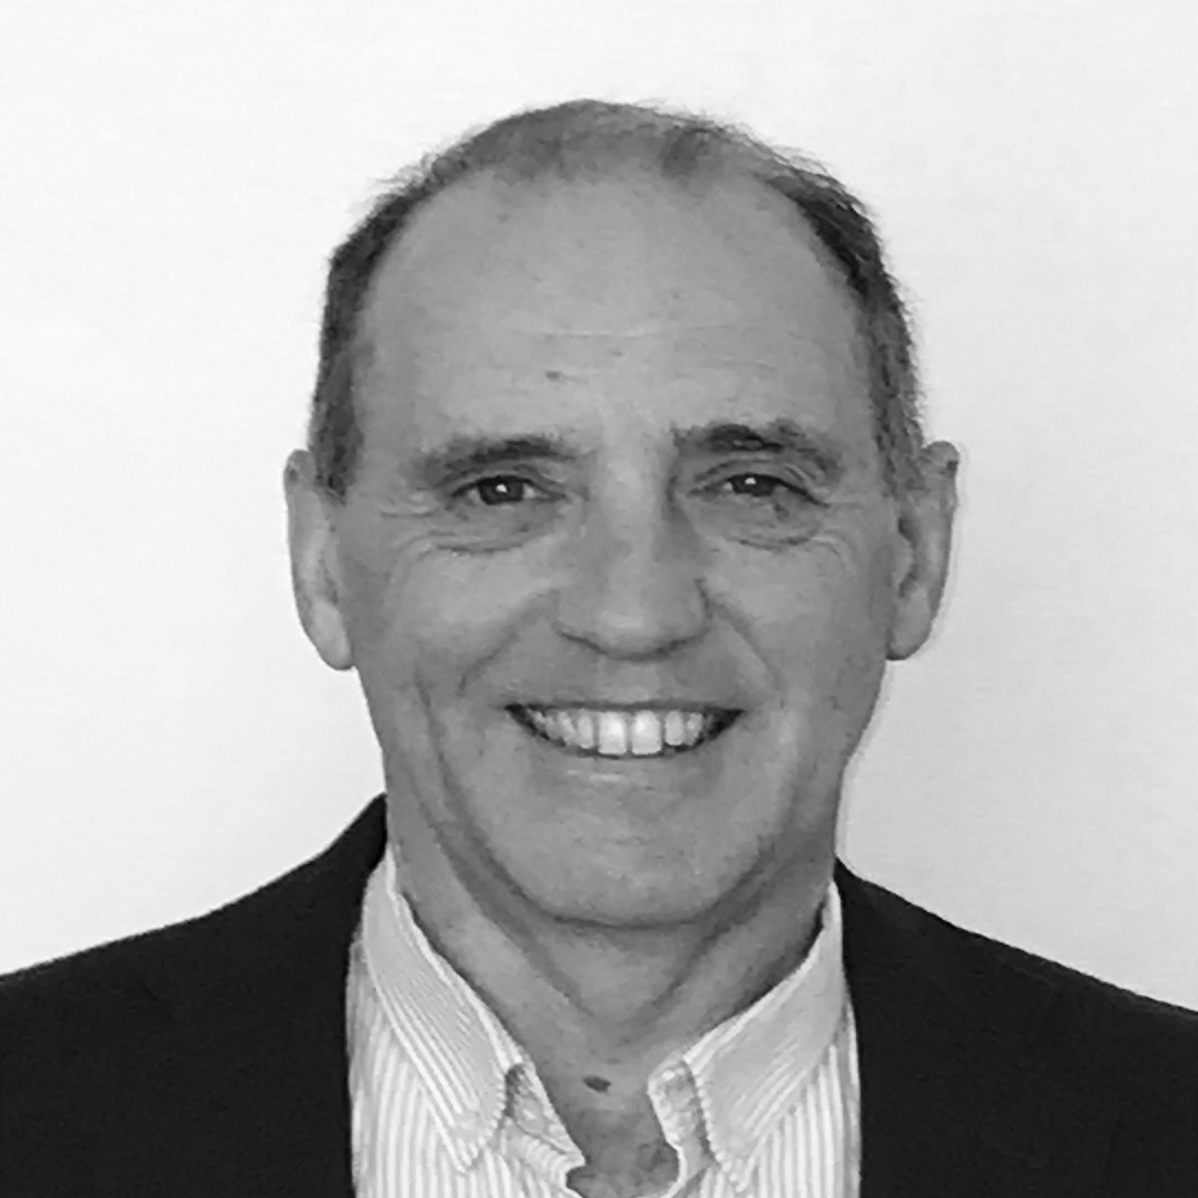
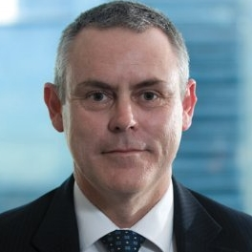
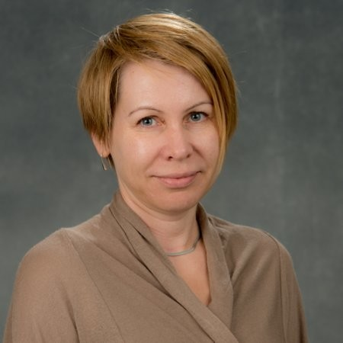
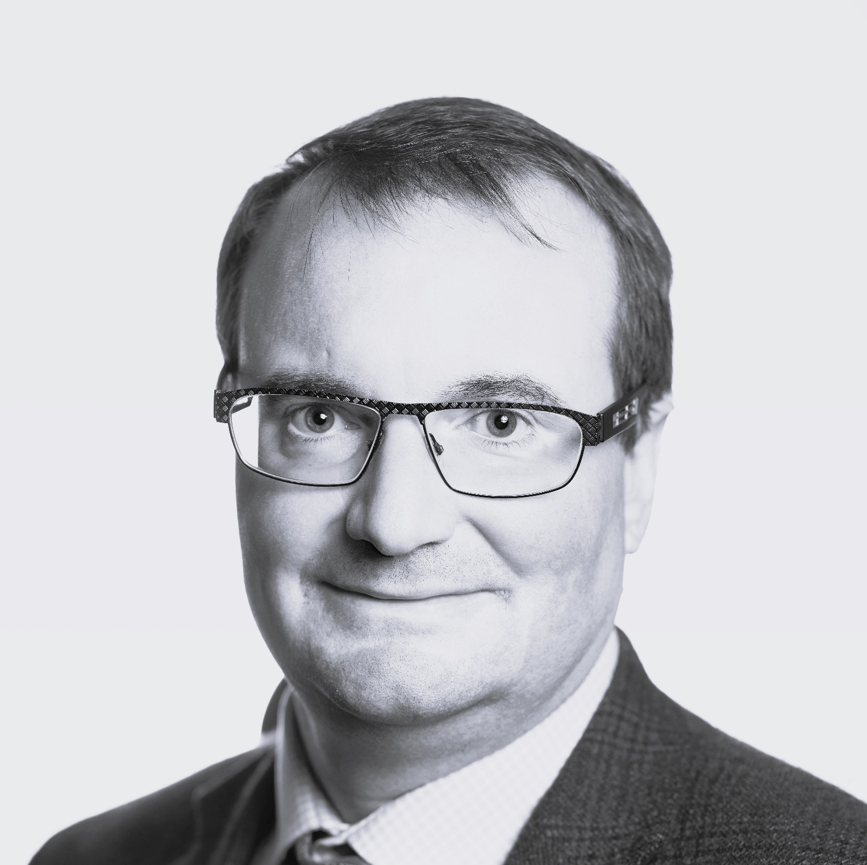
Board & senior management
Highly skilled and experienced senior leadership team with decades of experience
Dr Kilian Kelly
Chief Executive Officer & Managing Director
20+ years' experience in biopharma R&D
Previous roles at Biota Pharmaceuticals, Mesoblast, Amgen & AstraZeneca
Dr Geoff Brooke
Independent Non-Executive Chair
30+ years' experience in the healthcare investment industry
Founder and MD of Medvest Inc and GBS Venture Partners
Dr Paul Wotton Independent Non-Executive Director
30+ years' experience
Previously CEO of Ocata Therapeutics (acquired by Astellas) and Obsidian Therapeutics
EY Entrepreneur of the Year (NJ, 2014)
Ms Janine Rolfe
Independent Non-Executive Director
20+ years legal, governance and management experience across multiple sectors
Founder of Company Matters
Dr Darryl Maher
Independent Non-Executive Director
Former Vice President, R&D and Medical Affairs at CSL Behring
Former President of Australian Pharmaceutical Physicians Association and Director of Vaccine Solutions
Mr Peter Webse
Company Secretary
25+ years company secretarial experience
Director of Governance Corporate Pty Ltd
Dr Jolanta Airey
Chief Medical Officer
25+ years' experience in respiratory, rheumatology, dermatology, biologicals and listed companies
Previously Director, Translational Development at CSL
Dr Mathias Kroll
Chief Business Officer
25+ years' experience in biopharmaceutical industry
Previously held leadership positions at various institutions, including Bayer, Sanofi-Aventis and GlaxoSmithKline

Slide 30
Upcoming catalysts* Results of three randomised controlled clinical trials expected between early 2025 and early 2026
Mid 2024
Renal trial – start of enrolment
2H 2024
Renal trial – results (Cohort A)
aGvHD trial – completion of enrolment
1H 2025
DFU trial – results (potentially late 2024)
2H 2025
aGvHD trial – results
1H 2026
OA trial - results
Results
Completion of enrolment
Results
Results
Start of enrolment

Slide 31
Summary
Next generation stem cell company | Leading platform technology in burgeoning stem cell sector Diverse and highly credentialed leadership team with proven experience
Scalable manufacturing | Cymerus™ manufacturing technology protected by robust patent portfolio Enables scalable production of consistent MSCs from a single donation from a single donor, overcoming major challenges with conventional approaches
Compelling clinical data | Very encouraging safety and efficacy results from aGvHD clinical trial (CYP-001) Promising initial data from ongoing DFU clinical trial (CYP-006TK)
Rich clinical pipeline | Broad pipeline with four active clinical programs FDA cleared IND for Phase 2 aGvHD clinical trial; study underway Patient enrolment complete in DFU & OA clinical trials Commencement of renal transplantation clinical trial imminent
Significant growth potential | Global estimated market opportunity across targeted indications of ~US$28bn¹ Focus on indications with significant unmet need Proactive B-2-B outreach to drive partnering strategy

Slide 32
Contact Us
Cynata Therapeutics Limited
Level 3, 100 Cubitt Street
Cremorne Victoria 3121
Australia
cynatatherapeutics
@cynatastemcells
cynata-therapeutics
info@cynata.com
www.cynata.com

